Slide 1


Welcome to the launch of
Year 9 GCSE Options Choices 2024
Ysgol Uwchradd Gatholic Archesgob McGrath

Slide 2
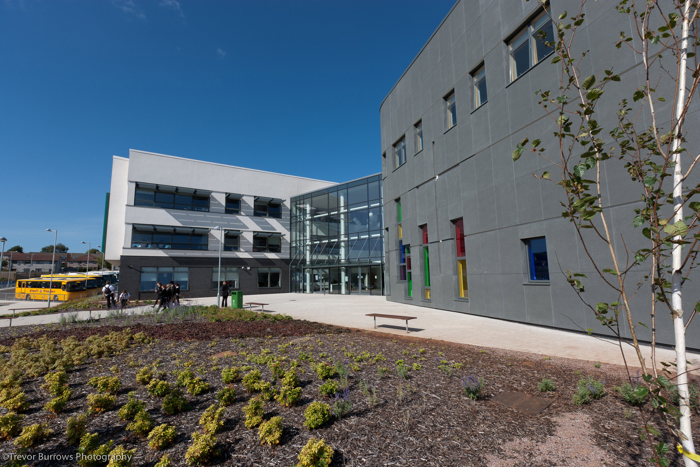

The Process of Options – What are Options?
Year 9 options are the decisions you will make as to which subjects you continue to study at GCSE level for Year 10 and Year 11
It is vital that you think carefully about the choices you make and the subjects you choose.
The decisions you make can impact on your future choices.

Slide 3


Core Curriculum
Mathematics & Numeracy | Science(s) | English Language and Literature
R.E | Welsh | PE

Slide 4
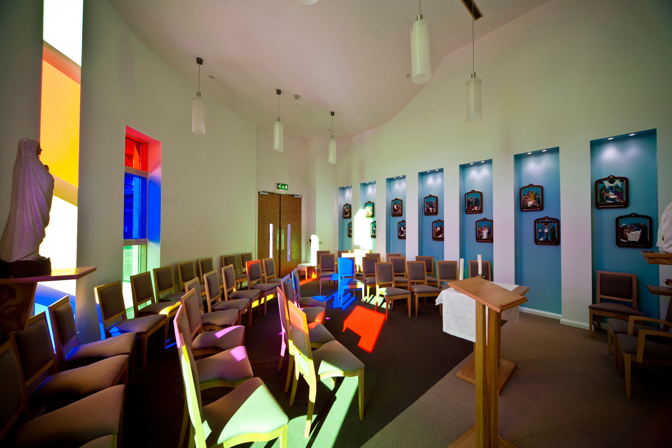

Art | Business Studies | Computing | Drama | Product Design
Heath and Social | Information Technology | Media Studies | Music | Food and Nutrition
Optional Subjects
You will then choose to study three optional subjects for GCSE in Years 10 and 11:
Skills Challenge Certificate
French | Georgraphy | History
PE | Learning in Outdoor Education | Prince’s Trust

Slide 5

Choose a subject because….
It suits your skills and abilities
It links to your future career choices
It suits your interests
It goes well with your other choices
It will help you meet the entry requirements for the post – 16 education that interest you
You think you might want to continue studying it at post 16 or beyond
You are good at it and/or think you might enjoy it.

Slide 6
Do not choose a subject because…
You think it will be easy
Your friends have chosen it
You like the teacher you have now
Someone else thinks that it is a good idea for you to do it
Options are your choice. Make the right decision for you based on what you have discovered and discussed about your hopes, goals and career aspirations.

Slide 7
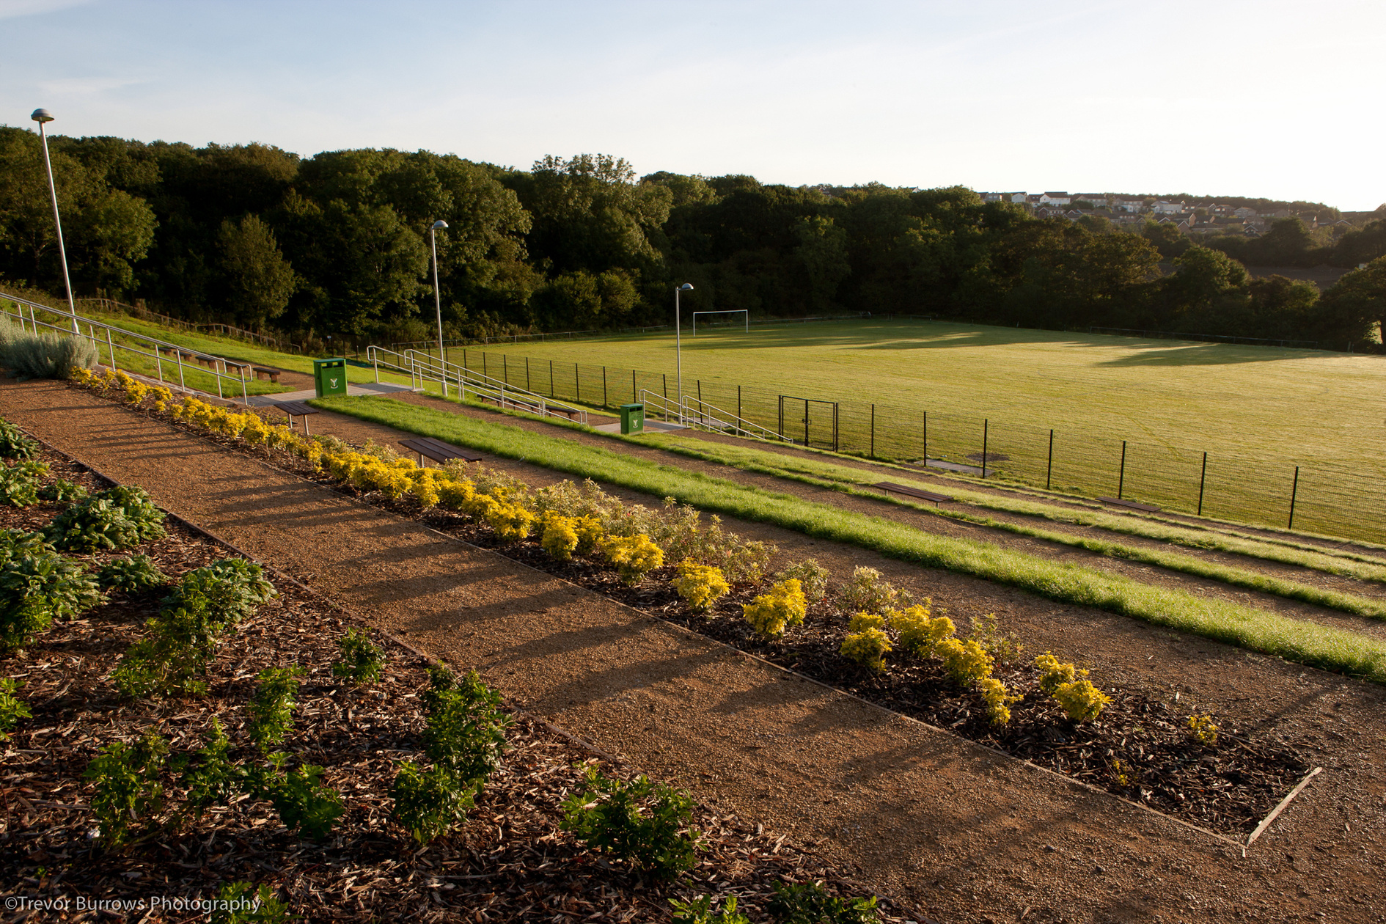
THINGS TO CONSIDER…
Which subjects are you good at? Which subjects do you enjoy? The two don't necessarily go hand in hand.
What assessment methods suit you? Although most GCSEs/BTECs are assessed by exams, practical work forms an important part of certain subjects.
If you have a particular career in mind, have you investigated which subjects are required?
If you are unsure about careers, are you choosing a broad enough range of subjects to keep as many options open as possible?
Are there any subjects you'd like to continue studying post-16?
What wider interests do you have? Certain subjects, such as art and design, music and PE, can be taken at school or continued as hobbies.
If you have already decided on some subjects, on what are you basing your decisions? Check that you are choosing a subject for the right reasons and not because you like the teacher, think it will be an easy option or because your friends are taking it!

Slide 8

MOVING FORWARD
What's next?
STEP 1- FREE CHOICE
Options Assembly
Research each option using the Options Website and discuss choices at home
Complete Free Choice Selection- You will be asked to select 3 options and 1 reserve option from a list of available subjects. This is not your final choice of options.
Attend Year 9 Options and Parents Evening on 30th January 2025 to meet core subject teachers and experience the optional subjects

Slide 9
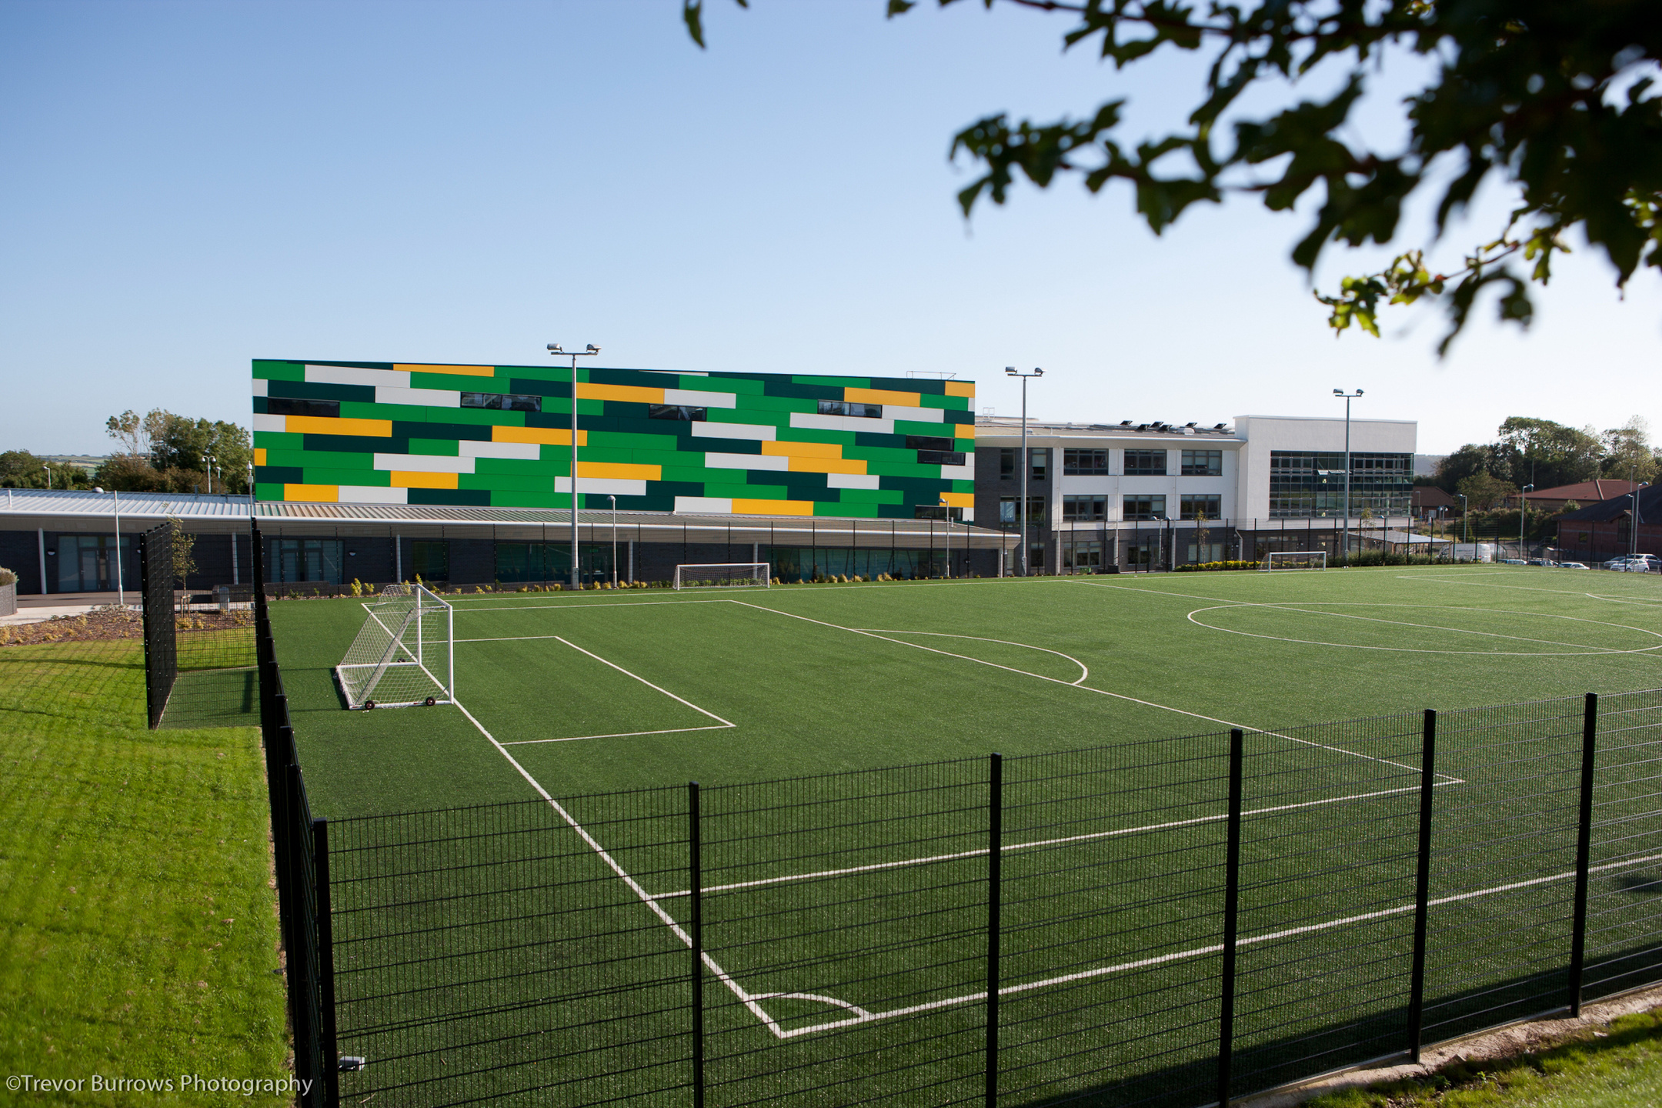
MOVING FORWARD
What's next?
STEP 2- FINAL OPTION CHOICES
Select 3 options again. This time you must select 1 option from each option block (A, B and C). You may find that some of the subjects that you wish to take are in the same column and you may have to consider alternative subjects.
Meet with Miss Edwards to discuss choices
Experience Careers activities and Taster Sessions with Mrs Farrow and Nicola Patalano

Slide 10
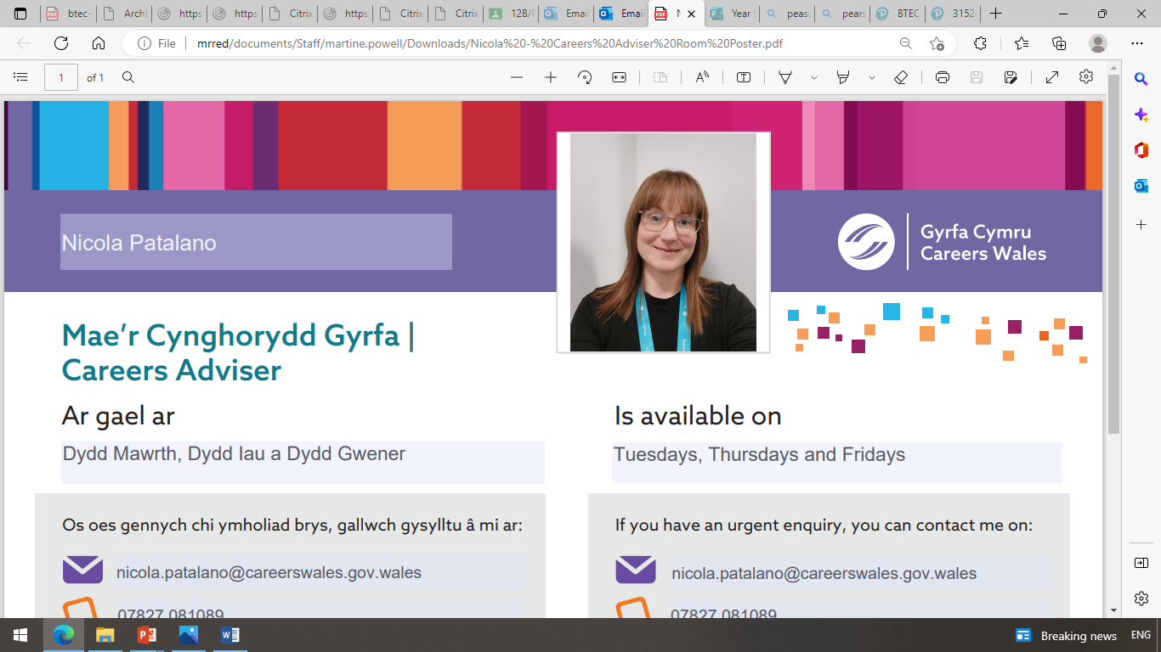

Where can I go for help and advice?
Year 9 Options and Parents Evening on 30th January 2025 to meet core subject teachers and experience the optional subjects

Slide 11


ANYTHING
I'VE MISSED?
Please feel free to ask any questions.
The future depends on what we do in the present.

Slide 12


