Slide 1
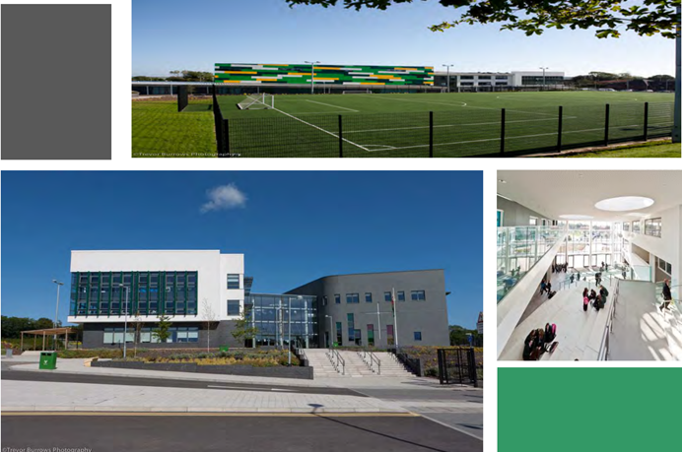

Archbishop McGrath
Catholic High School
Croeso
Year 11 Expectations Event

Slide 2

Our Vision
“Christ at the Centre”
Our core purpose is to ensure that all pupils reach or exceed their potential by using their God-given talents to develop as healthy, ambitious, capable life-long learners ready to live as valued members of our local community, Wales and the world.
We aim for all our pupils to leave our school as:
Employable, Virtuous and Empowered
Individuals.
We are #teamAMG

Slide 3
The purpose of this evening
To consolidate on last years achievements and outline the expectations for year 11.
Working together to ensure the success of every pupil, and they reach their full potential.
To be equipped to progress in the world after leaving school, which ever pathway we take.
Good balance between physical and mental wellbeing
A Catholic ethos at the heart of all that we do “Christ at the centre”

Slide 4
Expectations
Positive attitude
Focus in lessons
Make good progress
Completion of coursework and controlled assessment by set deadlines
To ask for help when needed top allow us to support them
Interventions to support development in key areas
Track and monitor progress
Aspirational yet realistic targets
Encouragement and support
Balance between school work and social life
To ensure every pupil has a successful destination

Slide 5

All members of Archbishop McGrath Catholic High School’s community are to be recognised as made in the image and likeness of God and respected accordingly. All members of the school community are encouraged to follow the example of Christ. In practice this means that everyone should strive to find opportunities to demonstrate the virtues of the Catholic Pupil Profile. By cooperating and trusting each other we aim to ensure that each pupil reaches the peak of their ability and God given talents. This is encompassed in the schools mission to ensure all pupils are Employable, Virtuous and Empowered (EVE).
#TeamAMG

Slide 6

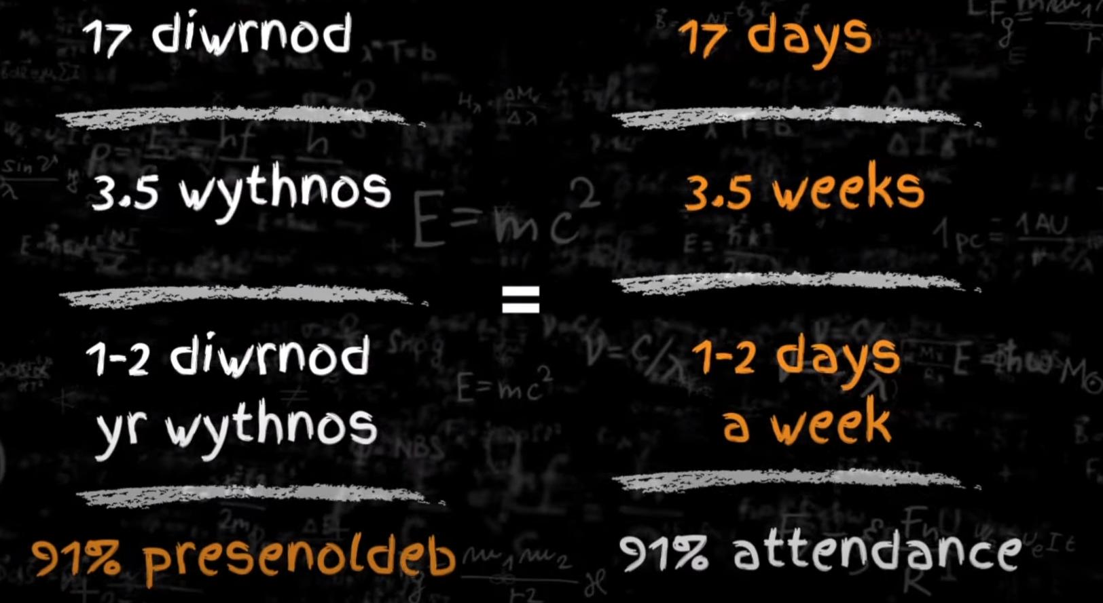
Attending school on time, every day, is not only important for a child’s learning, but also for their wellbeing, achievement, and overall development. Attending school gives children the best chance of success.
Parents/carers can support the regular and punctual attendance of their children by:
ensuring that their child arrives at school on time.
ensuring that their child only misses school for reasons which are unavoidable or justified, such as illness or days of religious observance.
notifying the school as soon as possible of any absence and confirm this in writing when the child returns to school.
not booking family holidays during term-time.
talking to the school if they are concerned that their child may be reluctant to attend.

Slide 7
Gweddi / Prayer (Our Father)
Attend to Achieve, Everyday Counts
Attendance Level | Judgement in terms of potential impact on reaching the school mission (Employable)
Attendance at 96% + | Excellent
91% - 95 | Needs monitoring and improvement, 50 – 85 equivalent hours of education missed
90 - 84% | Unacceptable, Cause for concern , 90 – 130 equivalent hours of education missed
85% and under | Major cause for concern – in excess of 140 hours of education missed
Notes:
GWEDDI / PRAYER OUR FATHER (WELSH ONLY)

Slide 8
Cymraeg

Slide 9
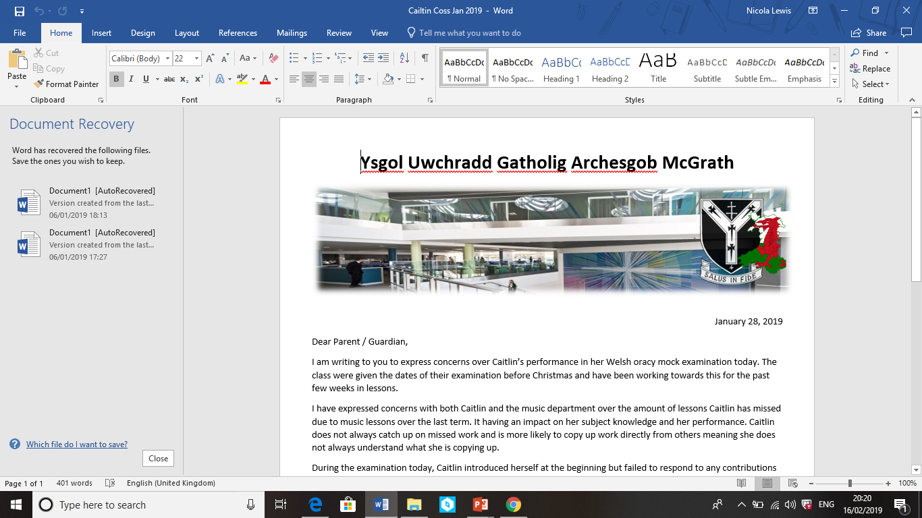
Cymraeg
Unit 1 | Unit 2 | Unit 3 | Unit 4
Oracy exam in pairs or groups (25% of GCSE) Pupils will be expected to watch a short video clip in Welsh, making comparisons with the content and continuing a discussion with their partner around the overarching theme of the clip. | Oracy exam in pairs or groups (25% of GCSE) Pupils will be expected to make use of a visual stimulus (infographic) in Welsh, continuing a discussion with their partner around the overarching theme of the visual stimulus. | Reading exam - 90 minutes (25% of GCSE) This will be an official exam in the exam hall. Students will complete a variety of reading exercises (although some extended writing tasks will also be involved) | Writing exam – 90 minutes (25% of GCSE) This will be an official exam in the exam hall. Students will complete a variety of written exercises (although some reading will also be involved)
Some classes have already completed unit 1 in Y10, some have completed unit 2 in Y10.
There is also an opportunity for students to resit the exam they have already completed to improve their grade.

Slide 10
Cymraeg
Exam dates Unit 1
March 18/19/20 2025
Pupils will not know the topic they will be expected to discuss beforehand.
Units 1 and 2 are worth 50 marks each and worth 25% of the GCSE.
Your child will usually be examined by their class teacher.
Exam dates Unit 2
March 25/26/27 2025
Pupils will not know the topic they will be expected to discuss beforehand.
Units 1 and 2 are worth 50 marks each and worth 25% of the GCSE.
Your child will usually be examined by their class teacher.

Slide 11
Cymraeg
What support is in place?
During lessons, pupils will practise oracy skills usually in their working groups on a selection of topics practising responding to the video or placemat.
Pupils will be given sentence structure tests / support tailored to target grade.
Pupils will complete assessments throughout the course in all skills and receive detailed feedback from their teacher on how to improve.
EXPECT LOTS OF LOW STAKE TESTING OF KEY VOCABULARY AND SENTENCE STRUCTURES
Teachers will upload support materials to Google Classroom where students can get in touch if they need any additional support or have any questions.
All students should have signed into their Welsh Google Classroom which is populated by their class teacher. Additional resources including revision help and classroom support will be uploaded here.
Students can use the links below to access additional support including helpmats and past paper style questions to work on independently. Links will be added in GC.

Slide 12

Padlet
Padlet
Unit 1 | Unit 2 | Unit 3 | Unit 4
https://padlet.com/MissLewisCymraeg/5udm7poxigpg | https://padlet.com/MissLewisCymraeg/a5c2mdm43rmg | https://padlet.com/MissLewisCymraeg/p77jvxr0rlp6 | https://padlet.com/MissLewisCymraeg/ot49amze89be

Slide 13

nicola.lewis@archbishopmg.co.uk
Should you have any queries, please contact me on the address below
Diolch yn fawr iawn!

Slide 14
English

Slide 15






GCSE English Language Course Outline
Unit 1 (20%) - Oracy
Task 1 (10%): Individual Researched Presentation.
Completed. Marks will be shared the week beginning 14th October.
Task 2 (10%): Group Discussion - January 2025.
Unit 2 (40%) - Description, Narration and Exposition Exam – Friday 23rd May ’25
Section A (20%): Reading - A series of questions relating to a range of texts.
Section B (20%): Writing - One proofreading task.
One extended writing task.
Unit 3 (40%) - Persuasion, Argumentation and Instructional Exam – Friday 6th June ‘25
Section A (20%): Reading - A series of questions relating to a range of texts.
Section B (20%): Writing - One compulsory argumentation writing task and one compulsory persuasive writing task. e.g. letter/article/report/guide/review, etc.

Slide 16





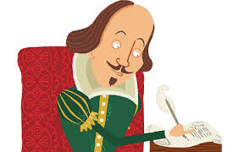

GCSE English Literature Course Outline
Unit 1 (35%): Other Cultures Prose & Unseen Poetry - completed.
Unit 2 (40%): Prose and Drama Exam Tuesday 20th May ‘25
A 2 hour exam split into two sections, one on An Inspector Calls (play & context) and the other on Heroes;
OR
A View from the Bridge and Lord of the Flies (context).
Unit 3 (25%): 2 NEA Tasks
(12.5%): Shakespeare - analysis of set theme.
(12.5%): Welsh writing in English - comparative analysis of poems
written by Welsh poets.
November/December 2024
Poetry NEA marks will be shared the week beginning 14th October.

Slide 17




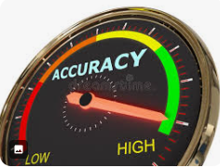
Key Dates for Year 11:
GCSE Literature Shakespeare (controlled assessment / NEA)
November/December 2024 (Shakespeare task based on a theme set by WJEC.)
Pupils will cover the drama text in class. Revision of key scenes and annotations for homework.
12.5% of final Literature award. (Added to poetry NEA mark 12.5%).
GCSE English Language Oracy Group Discussion Task (10%) January 2025
What should my son/daughter do to prepare?
Revise for the NEA.
Read around the oracy topic so they have plenty to contribute.
Read and annotate the Unit 2 texts.
Learn the key themes.
Revise relevant quotations and context.
Complete extract and essay questions.
Look at the resources on the WJEC and OER websites.
Use BBC Bitesize, Spark Notes, Shmoop,etc.
Use the booklets and websites shared by your teacher.
Attend revision sessions.
Focus on accuracy in all lessons. Revise key spellings.

Slide 18
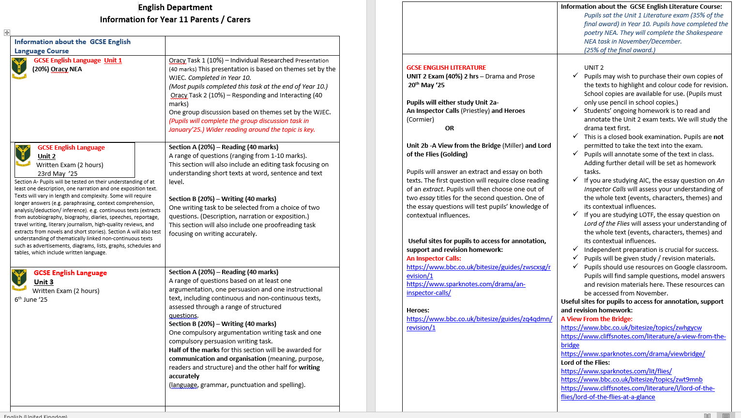

Slide 19


Mrs S Timbrell
Head of Mathematics

Slide 20

Qualifications
GCSE MATHEMATICS—NUMERACY
Unit 1: No Calculator
Unit 2: Calculator allowed
GCSE MATHEMATICS
Unit 1: No Calculator
Unit 2: Calculator allowed
Notes:
CLO

Slide 21
November Exam Dates
4th November Drop down
5th November Numeracy Paper 1
6th November Drop down
7th November Numeracy Paper 2

Slide 22

Revision Sessions
Miss Dawson Higher Revision – Thursday 3.15 to 4
Mrs Timbrell Higher – Wednesday 3.15-4.10
Mr Davies Intermediate – Wednesday or Thursday

Slide 23
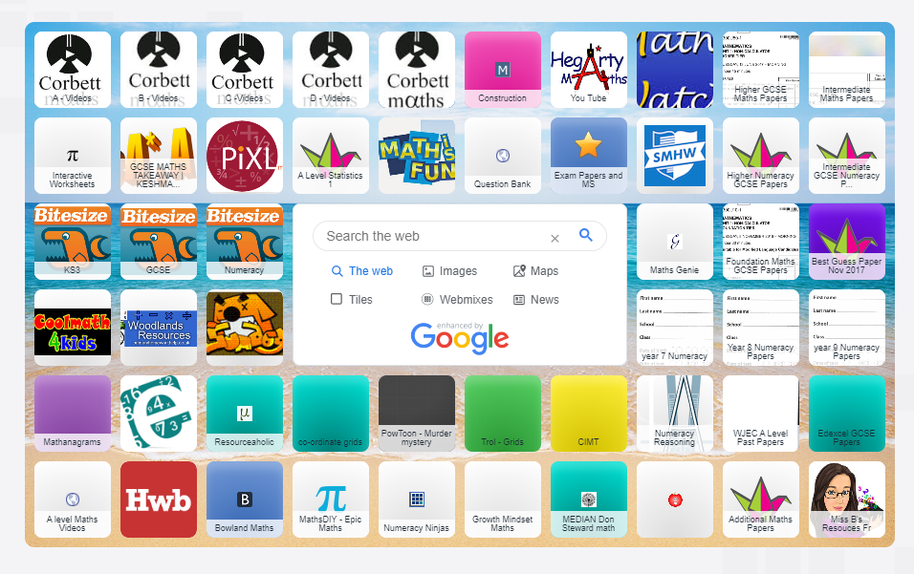
Learning online
https://www.symbaloo.com/mix/maths117

Slide 24
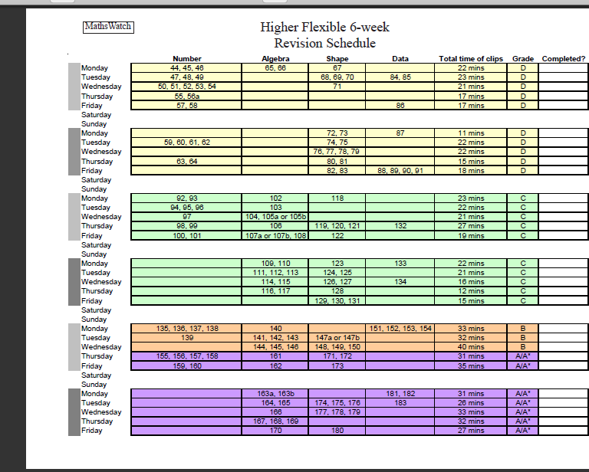
Mathswatch

Slide 25
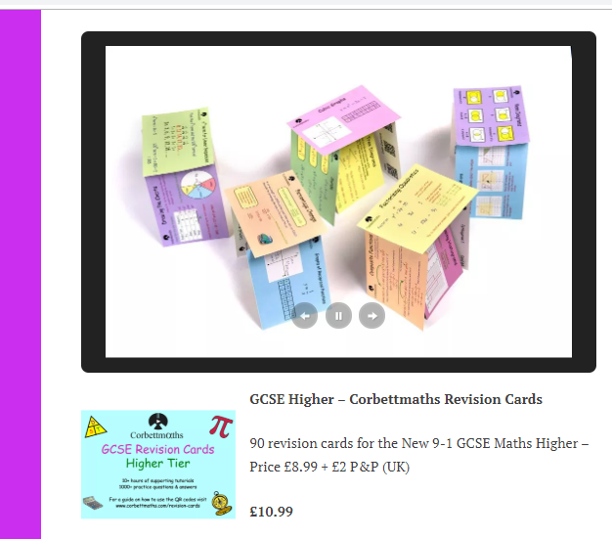
Revision Cards
Blank ones
Corbett Maths

Slide 26
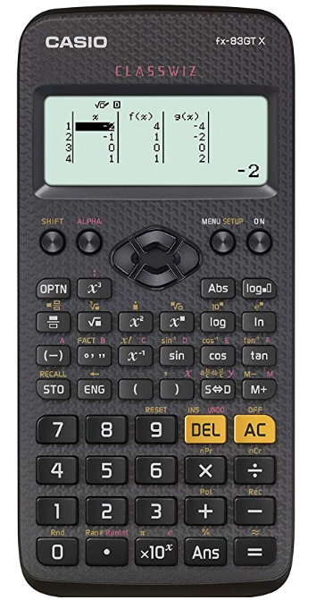
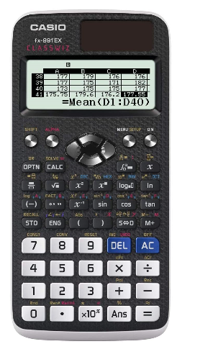
CASIO fx-83GT X
£10
RRP £15
CASIO fx-991EX
RRP £28

Slide 27

Study Tips for Pupils…
Do not revise for more than 1 hour without taking a 5-10 minute break. Stay hydrated and drink water.
Stay focused. Hours can be easily wasted on social networks and mobile phones. Revise when you are most alert.
Plan to revise specific topics.
Target difficult topics and do not avoid them.
Have a revision area at home.
Motivate yourself. Find a reason to want to succeed.
Answer questions from past papers, Maths DIY has great resources
Make your own papers on WJEC exam builder.
Don’t leave revision until last minute. Eat properly. Sleep properly.
Enjoy it!!

Slide 28
Parents can…
Ensure students complete all homework tasks on time
Ensure students attend revision sessions
Ensure students have all materials needed for a successful revision programme
Reward/praise students for their hard work
Help them learn their formulas’!!
Ask the Maths Department for support
Notes:
SHE

Slide 29

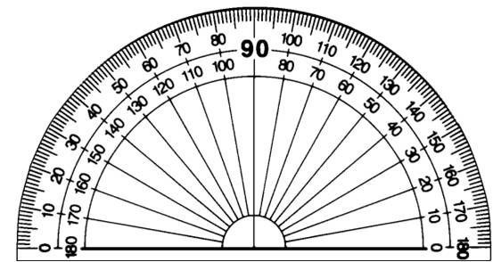



Other equipment

Slide 30

Contact Twitter @archbishopmaths
Sarah.timbrell@archbishopmg.co.uk

Slide 31
GCSE Science
Triple Science Award:
3 qualifications- Biology, Chemistry & Physics.
Practical coursework – 10% - January-February
Double Applied Science Award:
A mix of biology, chemistry and physics in the real world, e.g use of radiotherapy using ionising radiation in the treatment of cancer.
30% task based assessment- one in November and one in January-February.

Slide 32
GCSE Science
Students have already sat the unit 1 modules in Triple Science.
Students have sat unit 1 & 2 in Applied Science.
This means there is an indication of performance and a score that is generated towards the total award.
Re-sitting units may be necessary to have the best opportunity in achieving their target grade.

Slide 33
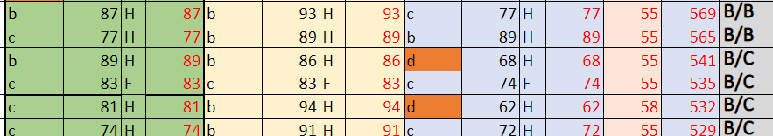
GCSE Science- Resits / predicted grades
Estimated overall score
Achieved in Y10
Resit
Practical CW in Jan-Feb
Repeat performance in Y11
Estimated Grade

Slide 34
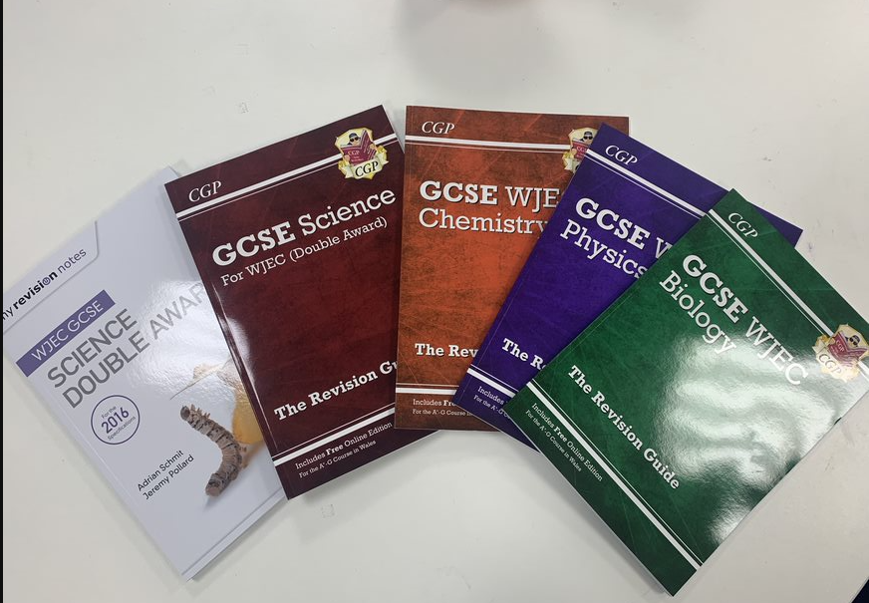
GCSE Science-
what you can do at home and what we’re doing:
Ensure that revision is as effective as possible – No mobile phones, short, sharp sessions, ideally no music, create a revision timetable.
Flashcards, Revision books- available through school or email Richard.jones@archbishopmg.co.uk
for ISBN (ISBN on next slide).
Lunchtime revision sessions and intervention
classes.

Slide 35
GCSE Science- ISBN for revision books
CGP- Physics- 978 1 78908 343 9
CGP- Chemistry- 978 1 78908 342 2
CGP- Biology- 978 1 78908 341 5
CGP- Double science- 978 1 78908 081 0
My revision notes- Physics- 978 1 4718 8356 9
My revision notes- Biology- 978 1 4718 8350 7
My revision notes- Chemistry- 978 1 4718 8353 8
My revision notes- Double Science- 978 1 4718 8359 0
Applied science revision materials available – only photocopying costs apply.

Slide 36
RE GCSE
Pupils have already completed 50% of the RE GCSE in year 10 (apart from a small number who are re-sitting)
Pupils will be sitting Paper 2 (Unit 3) in June – worth 50% of overall GCSE​
2 hour paper​
The course consists of 4 units:
1 – Catholic Core beliefs and practices​
2 – Catholic Core beliefs and practices​
3 – Relationships
3 – Human Rights
​

Slide 37
How will we support your child?
All students will be provided with revision materials​
Weekly revision classes after school from the beginning of April
End of unit tests throughout the year in the style of GCSE question papers. Students will be expected to resit if they do not achieve their ALPs predicted grade
Regular key words/key concepts tests​
Full paper mock exam​
Thorough feedback in lessons

Slide 38
How can you support your child?
Encourage and engage in revision. The revision booklets are designed to be very user friendly and are written in a way that a parent/carer can easily test their child on any topic.​
Engage in homework set
​
Encourage the use of useful websites:​
​
BBC Bitesize​
WJEC website
For any questions or concerns, please contact
caroline.dunn@archbishopmg.co.uk

Slide 39
If you have any question please do not hesitate to contact
Year11expectation@archbishopmg.co.uk

Slide 40


