Slide 1
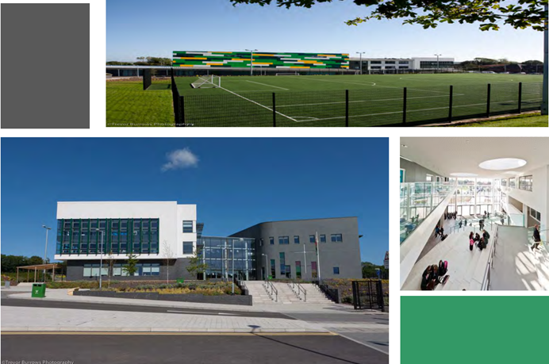

Archbishop McGrath
Catholic High School
Croeso
Year 10 Expectations Event

Slide 2

Our Vision
“Christ at the Centre”
Our core purpose is to ensure that all pupils reach or exceed their potential by using their God-given talents to develop as healthy, ambitious, capable life-long learners ready to live as valued members of our local community, Wales and the world.
We aim for all our pupils to leave our school as:
Employable, Virtuous and Empowered
Individuals.
We are #teamAMG

Slide 3
The purpose of this evening
To outline the expectations of the pupils and discuss the benefits of support from home and us and how we transition into key stage 4.
Working together to ensure the success of every pupil, and they reach their full potential.
Having a good balance between physical and mental wellbeing
A Catholic ethos at the heart of all that we do “Christ at the centre”
To be equipped to progress in the world or work after leaving school.

Slide 4
Expectations
Positive attitude
Focus in lessons
Make good progress
Completion of coursework and controlled assessment by set deadlines linked to calendar
Good attendance
To ask for help when needed allows us to support and ensure understanding
Interventions to support development in key subject areas
Track and monitor progress
Aspirational yet realistic targets
Encouragement and support
Balance between schoolwork and social life to support wellbeing.

Slide 5





Year 10 Wellbeing Support
Your child is able to access support from a number of staff within the Wellbeing team.
The first point of contact is your child’s form teacher who they see at 8.55am every morning.
Mr Hiscocks
Miss
Leeke
Miss Pearson
Mrs Crossman
Mr
Gwyn

Slide 6
Year 10 Wellbeing Support
Miss Burgess is our Key Stage 4 Wellbeing Support Officer and is based in the Wellbeing Office. Pupils can drop in during form or break times.
Parents and guardians can contact Miss Burgess on OPTION 3 on the school phone line or via email: claire.burgess@archbishopmg.co.uk
Mr Gallafant (Year 10 Leader of Wellbeing) can be found in the PE department or also in the Wellbeing Office.
Parents and guardians can contact Mr Gallafant via email:
will.gallafant@archbishopmg.co.uk
Mr Farrow is the SLT Lead for Key Stage 4 and links in with Miss Burgess and Mr Gallafant.

Slide 7

#attendtoachieve
Attending school on time supports your child’s wellbeing, achievement and overall development.
What can you do to support your child’s punctuality and attendance?
  Motivate your child to attend
  Ensure they arrive on time to school
  Notify and inform the school as soon as possible of your child’s absence and confirm this in writing with a note/letter for the office on your child’s return to school
  Minimise absence to only reasons that are unavoidable or justified (such as illness, attending medical appointments, days of religious observance)
  Avoid booking family holidays during term-time
  Share any concerns with the school if your child is reluctant to attend

Slide 8

All members of Archbishop McGrath Catholic High School’s community are to be recognised as made in the image and likeness of God and respected accordingly. All members of the school community are encouraged to follow the example of Christ. In practice this means that everyone should strive to find opportunities to demonstrate the virtues of the Catholic Pupil Profile. By cooperating and trusting each other we aim to ensure that each pupil reaches the peak of their ability and God given talents. This is encompassed in the schools mission to ensure all pupils are Employable, Virtuous and Empowered (EVE).
#TeamAMG

Slide 9
EXAMINATION DATES TO BE CONFIRMED
Richard Jones
Head of Science

Slide 10
Courses offered in science:
Triple Science (H&F)
Triple Science (H&F)
Double Applied Science (H&F)
Double Applied Science (H&F)
3 GCSE Qualifications consisting of Biology, Chemistry & Physics- A*-G
6 exams in total and 3 External Assessments
2 GCSE Qualifications consisting of Biology, Chemistry & Physics - A*-G
3 exams in total and 2 External Assessments
Triple Science: External assessment worth 10%
Double Applied Science: External assessments totaling 30%

Slide 11
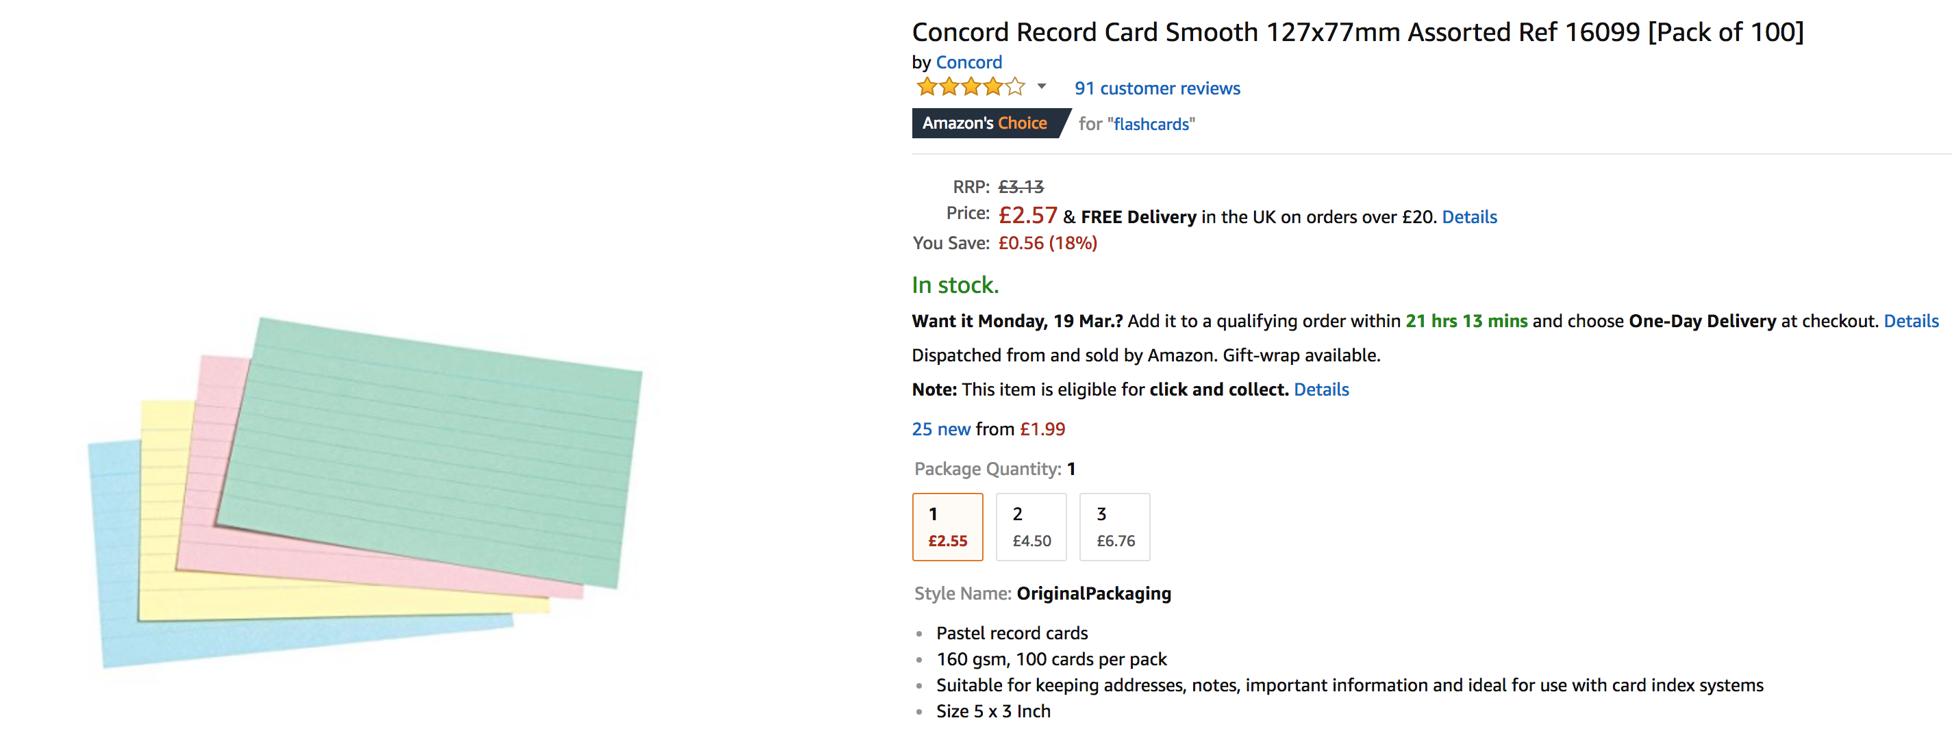
Plan your revision!
AVOID DISTRACTIONS!!
Revise away from mobile phone, at the dinner table/perhaps not in the bedroom etc. ​
Flashcards!
Apps! Bangor revision

Slide 12
Past papers, past papers, past papers!
There is no substitute to practicing questions that you are likely to come across.
You’ll learn the style of questioning and the content you need to brush up on.
Check your answers against the mark scheme. Anything you’re unsure of check with your teachers.
There will be paper copies of past papers available for a small fee. All past papers will also be made available online on Google Classroom.

Slide 13
What happens next?
End of topic tests will begin soon and all revision material will be available to students in the back of their booklets or on Google Classroom.
Preparation for these will be crucial and will help us identify areas that need addressing.
Any questions?
Richard.jones@archbishopmg.co.uk

Slide 14
English

Slide 15




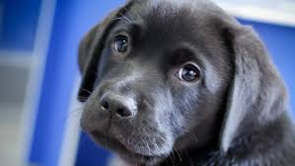

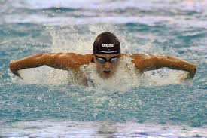
GCSE English Language Course Outline
Unit 1 (20%) - Oracy:
Task 1 (10%): Individual Researched Presentation. Year 10
Task 2 (10%): Group Discussion (on themes set by WJEC). Year 11
Unit 2 (40%) - Description, Narration and Exposition Year 11 Exam
Section A (20%): Reading - A series of questions relating to a range of texts.
Section B (20%): Writing - One proofreading task.
One extended writing task.
Unit 3 (40%) - Persuasion, Argumentation and Instructional Year 11 Exam
Section A (20%): Reading - A series of questions relating to a range of texts.
Section B (20%): Writing - One compulsory argumentation writing task and one compulsory persuasive writing task. e.g. letter/article/report/guide, etc.

Slide 16






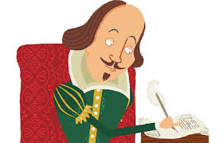
GCSE English Literature Course Outline
Unit 1 (35%): Other Cultures Prose & Unseen Poetry (Closed book)
Section A (21%): Of Mice and Men (Steinbeck) –extract and essay.
Section B (14%): Unseen poetry comparison. Year 10 External GCSE Exam:12th May 2025
Unit 2 (40%): Prose and Drama
A 2 hour exam split into two sections, one on An Inspector Calls and the other on Heroes, OR
A View from the Bridge and Lord of the Flies. Year 11
Unit 3 (25%): 2 NEA Tasks
(12.5%): Shakespeare - analysis of set theme in Macbeth / Romeo and Juliet. Year 11
(12.5%): Welsh writing in English - comparative analysis of poems
written by Welsh poets. Year 10

Slide 17

Key Dates for Year 10:
GCSE Literature Poetry (controlled assessment / NEA) December 2024
(Comparison of 2 poems by Welsh writers studied in October/November.)
Pupils will cover the poems in class. Revision homework.
Unit 1 Literature – 12th May 2025– Of Mice and Men and
unseen poetry comparison. (35%of Literature GCSE award)
GCSE English Language Oracy Individual Researched Presentation - June/July 2025
What should my son/daughter do to prepare?
Read and annotate Of Mice and Men.
Learn the key themes.
Revise relevant quotations.
Complete extract and essay questions.
Look at the resources on the WJEC and OER websites.
Use BBC Bitesize, Spark Notes, Shmoop,etc.
Use the booklets and websites shared by your teacher.
Attend revision sessions.

Slide 18

Please take one!

Slide 19


Mrs S Timbrell
Head of Mathematics

Slide 20

Qualifications
GCSE MATHEMATICS—NUMERACY
Unit 1: No Calculator
Unit 2: Calculator allowed
GCSE MATHEMATICS
Unit 1: No Calculator
Unit 2: Calculator allowed
Notes:
CLO

Slide 21



Year 10 Classes
Year 10 Higher Mrs Earnshaw | Year 10 Higher /Intermediate Miss Dawson
Year 10 Intermediate Miss Harris-Waters | Year 10 Intermediate ST Miss Harris-Waters
Year 10 Foundation Mr McShane and Miss Harris-Waters

Slide 22
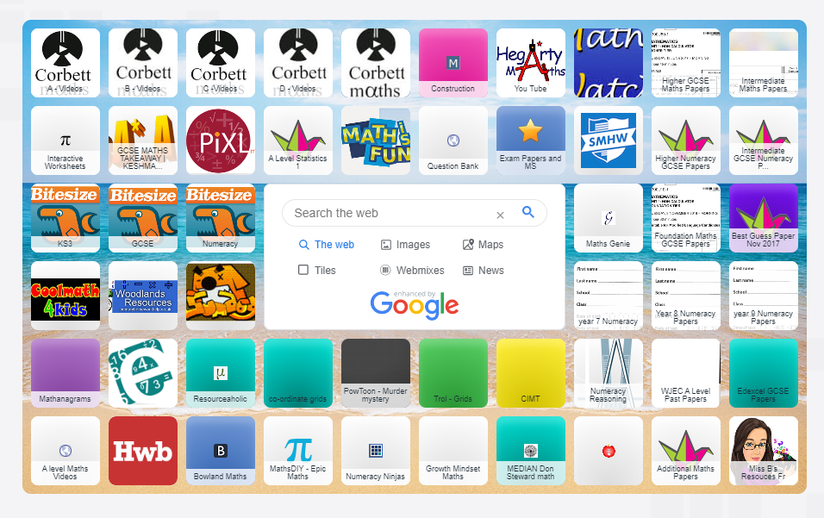
Learning online
https://www.symbaloo.com/mix/maths117

Slide 23
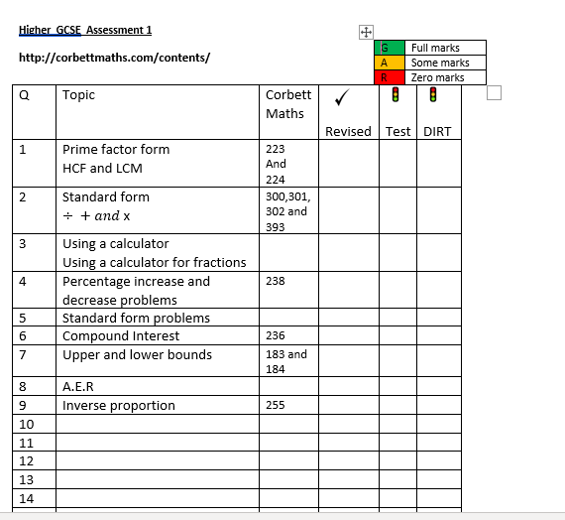

Half Termly Assessments

Slide 24
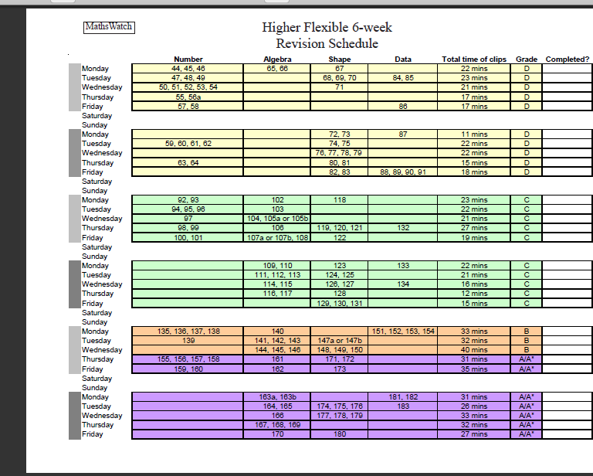
Mathswatch

Slide 25
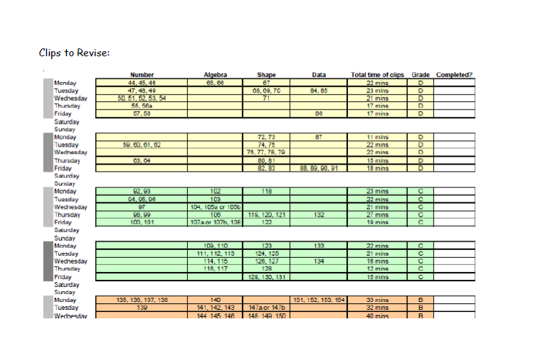

Slide 26
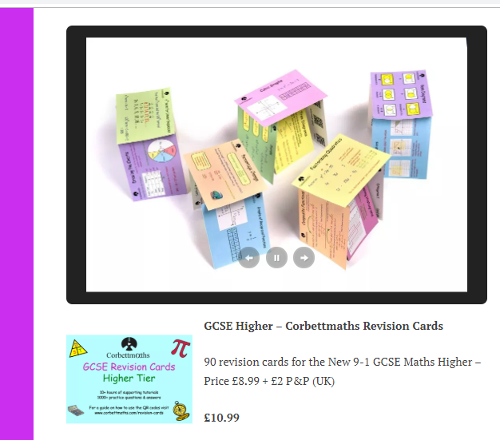
Revision Cards
Blank ones
Corbett Maths

Slide 27
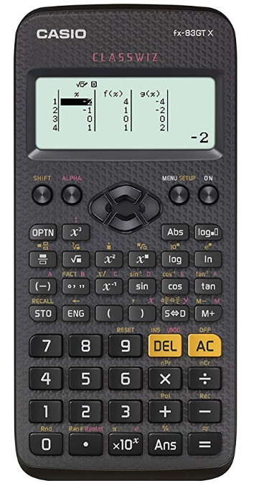
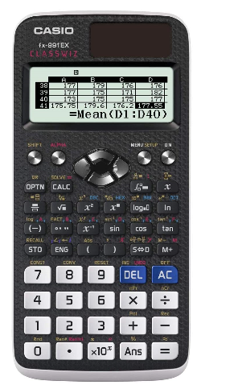
CASIO fx-83GT X
£11 -£16
CASIO fx-991 CW
RRP £35

Slide 28

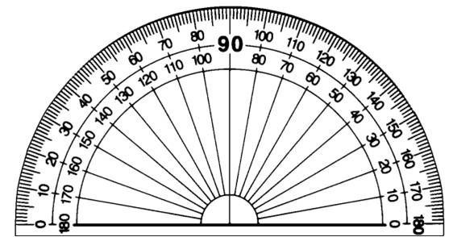



Other equipment

Slide 29

Study Tips for Pupils…
Do not revise for more than 1 hour without taking a 5-10 minute break. Stay hydrated and drink water.
Stay focused. Hours can be easily wasted on social networks and mobile phones. Revise when you are most alert.
Plan to revise specific topics.
Target difficult topics and do not avoid them.
Have a revision area at home.
Motivate yourself. Find a reason to want to succeed.
Answer questions from past papers, Maths DIY has great resources
Make your own papers on WJEC exam builder.
Don’t leave revision until last minute. Eat properly. Sleep properly.
Enjoy it!!

Slide 30
Parents can…
Ensure students complete all homework tasks on time
Ensure students attend revision sessions
Ensure students have all materials needed for a successful revision programme
Reward/praise students for their hard work
Help them learn their formulas’!!
Ask the Maths Department for support
Notes:
SHE

Slide 31
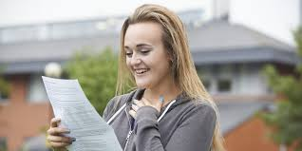



Slide 32

Sarah.timbrell@archbishopmg.co.uk

Slide 33
Welsh
https://www.loom.com/share/dbb0c860f92044bfa293fe368cbb6c94?sid=e652cdc9-18b1-4bb4-a002-f44c5562abbf

Slide 34
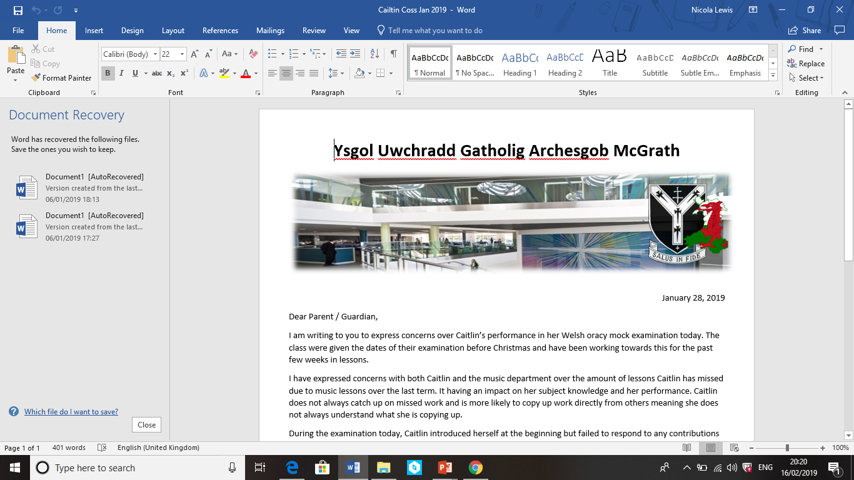
Cymraeg
Unit 1 | Unit 2 | Unit 3 | Unit 4
Oracy exam in pairs or groups (25% of GCSE) Pupils will be expected to watch a short video clip in Welsh, making comparisons with the content and continuing a discussion with their partner around the overarching theme of the clip. | Oracy exam in pairs or groups (25% of GCSE) Pupils will be expected to make use of a visual stimulus (infographic) in Welsh, continuing a discussion with their partner around the overarching theme of the visual stimulus. | Reading exam - 90 minutes (25% of GCSE) This will be an official exam in the exam hall. Students will complete a variety of reading exercises (although some extended writing tasks will also be involved) | Writing exam – 90 minutes (25% of GCSE) This will be an official exam in the exam hall. Students will complete a variety of written exercises (although some reading will also be involved)

Slide 35
Cymraeg
Units 1 and 2 (Pair / group) (1 in Y10 and 1 in Y11)
Pupils will not know the topic they will be expected to discuss beforehand.
Units 1 and 2 are worth 50 marks each and worth 25% of the GCSE.
Your child will usually be examined by their class teacher.
Units 3 and 4 (Individual) - Year 11
These units will be sat in the exam hall and marked externally by the WJEC.
Units 3 and 4 are worth 50 marks each and worth 25% of the GCSE.

Slide 36
Cymraeg
What support is in place?
During lessons, pupils will practise oracy skills usually in their working groups on a selection of topics practising responding to the video or placemat.
Pupils will be given sentence structure tests / support tailored to target grade.
Pupils will complete assessments throughout the course in all skills and receive detailed feedback from their teacher on how to improve.
Teachers will upload support materials to Google Classroom where students can get in touch if they need any additional support or have any questions.
All students should have signed into their Welsh Google Classroom which is populated by their class teacher. Additional resources including revision help and classroom support will be uploaded here.
Students can use the links below to access additional support including helpmats and past paper style questions to work on independently. Links will be added in GC.
Unit 1 | Unit 2 | Unit 3 | Unit 4
https://padlet.com/MissLewisCymraeg/5udm7poxigpg | https://padlet.com/MissLewisCymraeg/a5c2mdm43rmg | https://padlet.com/MissLewisCymraeg/p77jvxr0rlp6 | https://padlet.com/MissLewisCymraeg/ot49amze89be

Slide 37

nicola.lewis@archbishopmg.co.uk
Should you have any queries, please contact me on the address below
Diolch yn fawr iawn!

Slide 38
Religious Education

Slide 39
YEAR 10:GCSE RE
Pupils will be sitting two exams in total over the two years.
The first exam will be this summer:
Paper 1 (50%) – on everything they covered in Year 10 (May)

Slide 40
Paper 1
Theme 1 – Catholic Core beliefs, teachings and practices
Theme 2 – Jewish Core beliefs, teachings and practices
Theme 3 – Issues of Life and Death
Theme 4 – Issues of Good and Evil
The paper will have 4 questions (one on each theme) and will be 2 hours long.

Slide 41
How we will support your child
Continue to assess regularly – end of unit tests
Key words tests
Provide revision materials and course materials
Provide additional revision sessions from March
If you have any questions, please do not hesitate to get in touch:
caroline.dunn@archbishopmg.co.uk

Slide 42
How can you support your child?
Engage in their learning – ask questions/test
Encourage the use of useful websites
Useful websites:
- BBC Bitesize
WJEC
caroline.dunn@archbishopmg.co.uk

Slide 43
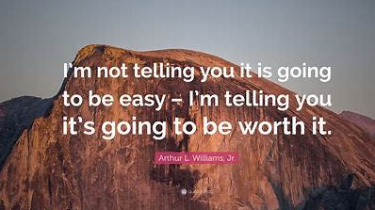

Slide 44
If you have any questions please do not hesitate to contact
Year10expectation@archbishopmg.co.uk

