Slide 1
Cardiff & Menevia Youth
Summer 2024

Slide 2
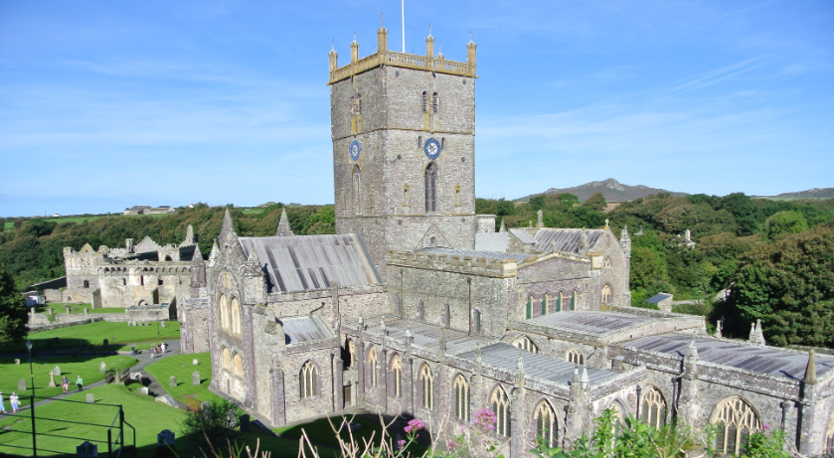
St David’s as a place of Pilgrimage
Monastic community established in 6th century
Centre of prayer
Important place for Celtic Christendom
awareness of the continuing presence of God in all things
closeness to nature
place where holiness and nature meet
Cathedral built in 12th century
Papal privilege granted as a place of pilgrimage
Notes:
Pilgrims travel to have an experience of God.

Slide 3
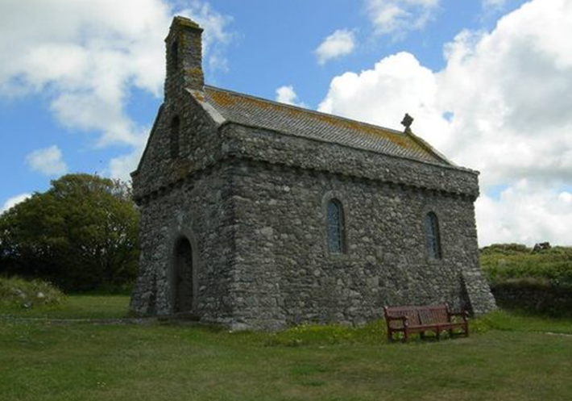
Time with God
Morning prayer, Mass, Formation, visiting holy sites
Time with like minded people
Friendship, discussion and questions, reflection, fun!
Notes:
TO go oln pilgrimage is to go looking for an experience of God.
IN the way that the holy women and men of Celtic Christendom

Slide 4
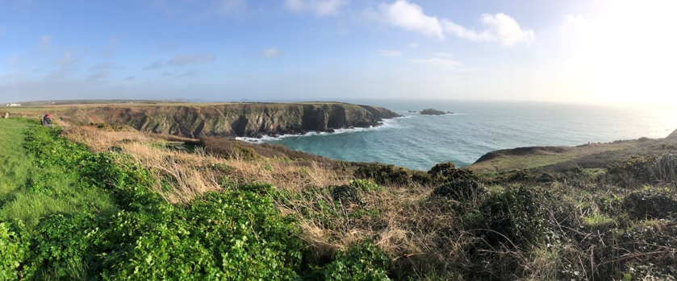

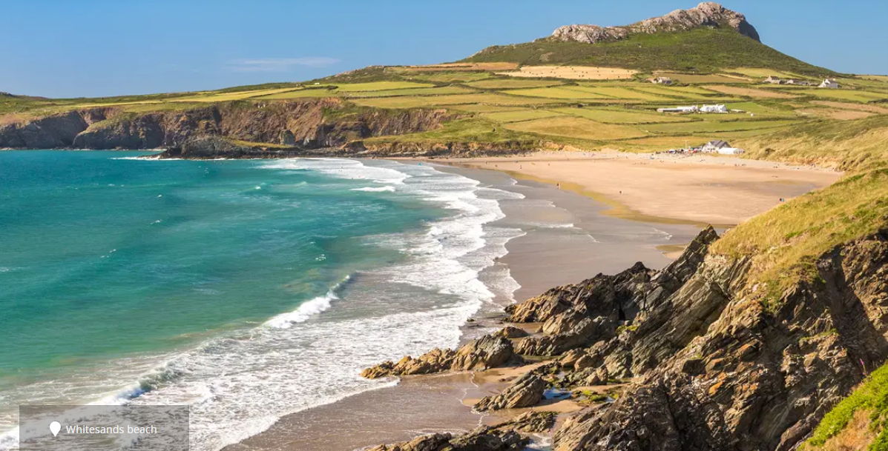
Fantastic scenery,
beaches and wildlife
Lots of walking!

Slide 5
WHO
Years 9 to year 13 i.e. 14 to 18 years of age
Clergy, Adult leaders, young leaders
WHEN
Wednesday 24th until Sunday 29th July 2024
WHERE
Staying in St David’s bunkhouses
Notes:
Frs Matt and Benny will be the spiritual leaders.His Grace will join us for a couple of days at the end. Ben and I will organise and lead with some other adults and there will be a few young

Slide 6
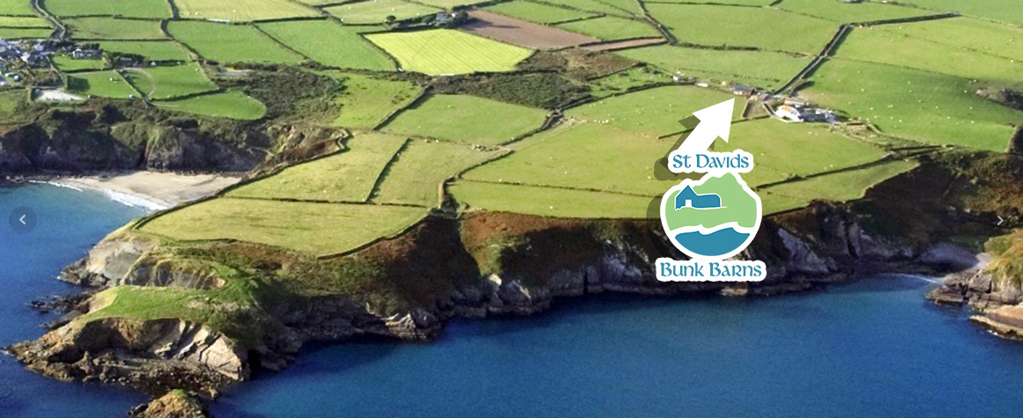
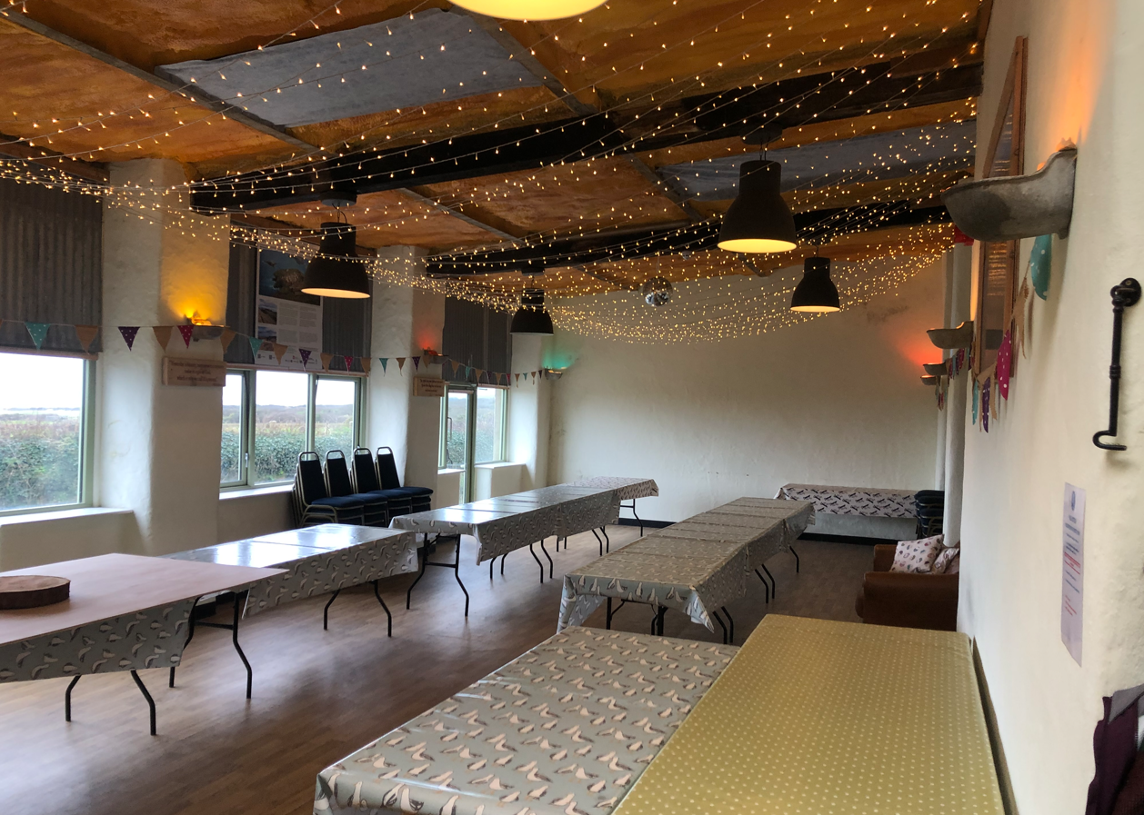
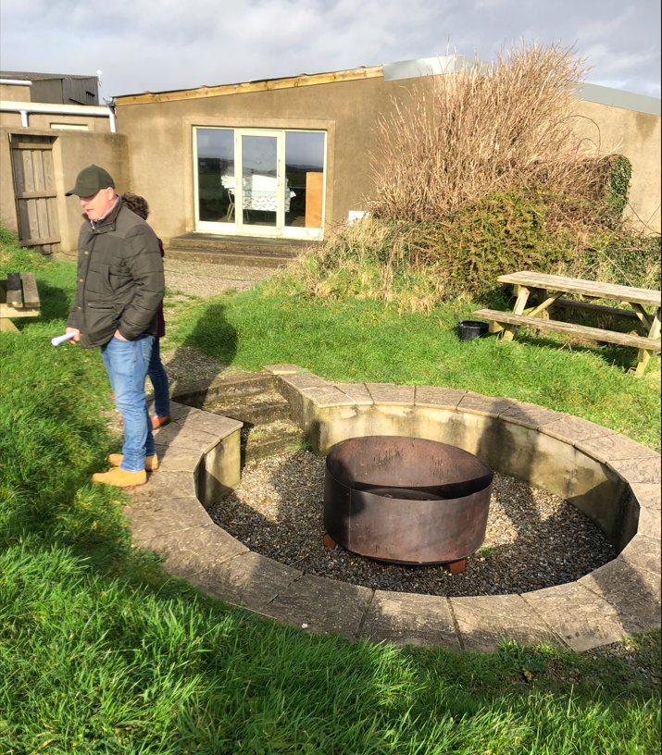
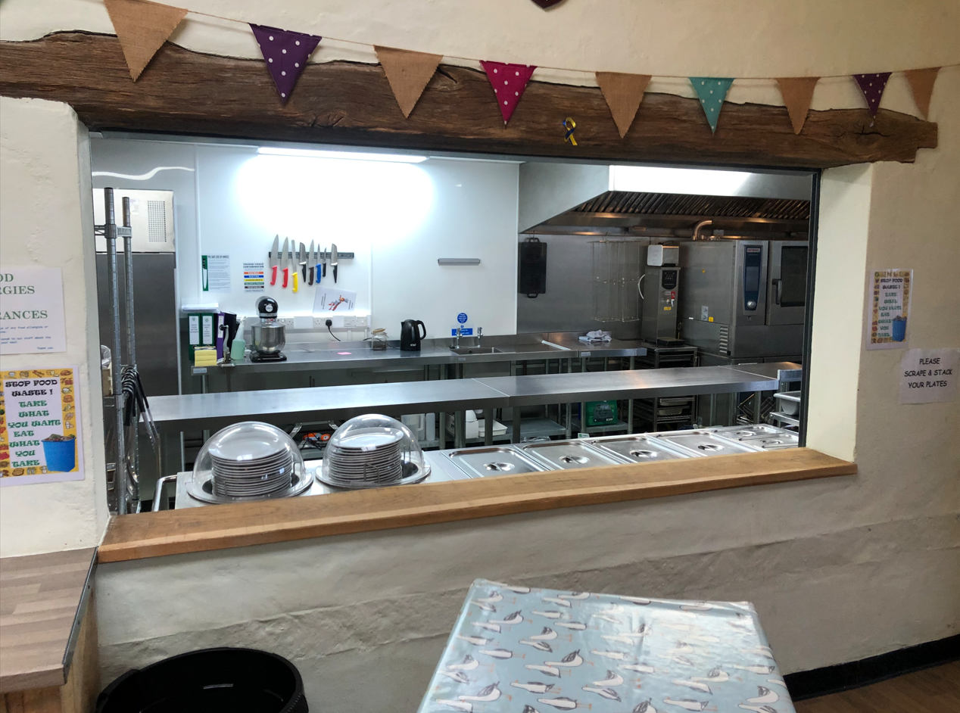
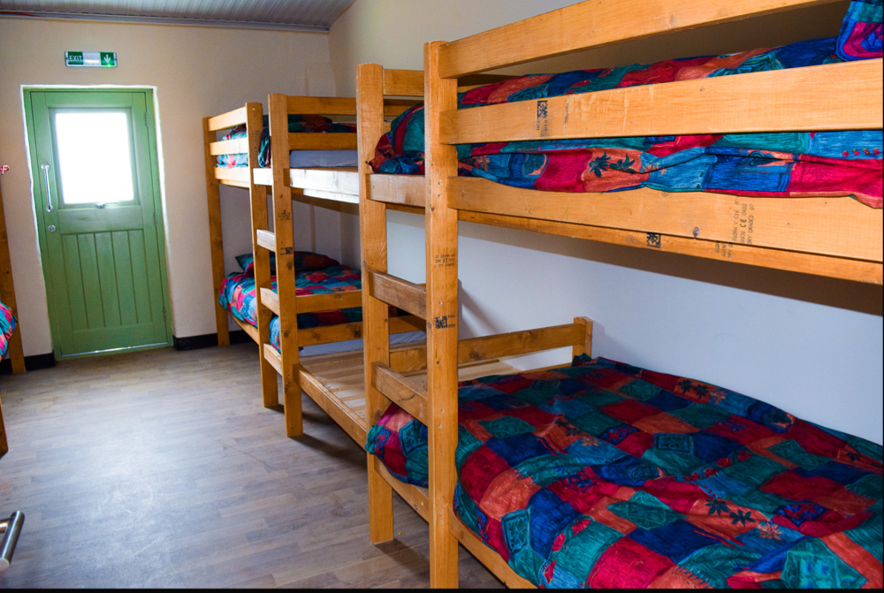

Slide 7
Preparatory meetings in May and June
Cost approx. £250, incl coach travel
Information from :
youth@rcadc.org

